Slide 1
Emotion Recognition Through Audio Analysis
By: Michael So

Slide 2
Background
What is Speech Emotion Recognition (SER)?
Why is this important?
Use cases
Virtual Assistants
Caller Agents
Transcription

Slide 3

Emotion Representation Theory

Slide 4


Slide 5
Neural Network
“A neural network is a series of algorithms that endeavors to recognize underlying relationships in a set of data through a process that mimics the way the human brain operates.”[2]

Slide 6
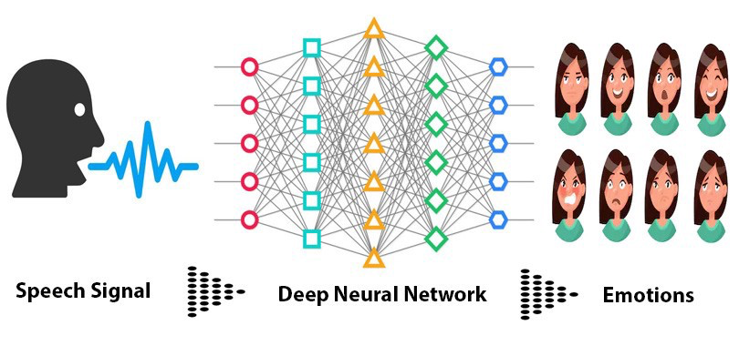

Slide 7
Looking Forward
More research → Better Technology
Improvements in:
Virtual Assistants (Siri, Alexa, Google, etc...)
Caller Agents
Text Transcription (Voice mails)

Slide 8
Questions?

Slide 9
Sources
Nasim, Sheena. “Speech Emotion Recognition Using Deep Learning.” Blog, https://blog.dataiku.com/speech-emotion-recognition-deep-learning.
Chen, James. “What Is a Neural Network?” Investopedia, Investopedia, 22 Sept. 2022, https://www.investopedia.com/terms/n/neuralnetwork.asp.

